Slide 1
Prefixes
Prefixes are found BEFORE a base word and can change a words’ meaning.

Slide 2
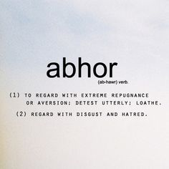
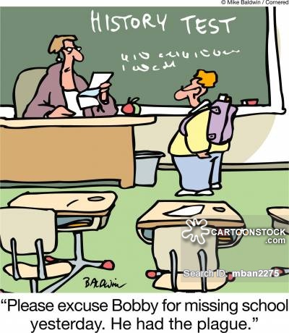
a-, ab-, abs-
1
ABDUCTION - abduct - carry away by force
ABSENT away, not present
ABSTRACT
abnormal - away from normal, not normal
aversion - the act of turning away from
from
away
away from

Slide 3
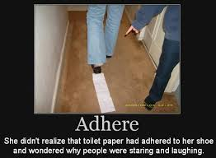
ad-
2
to
motion toward
addition to

Slide 4
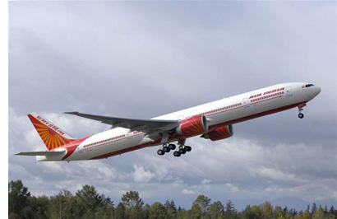
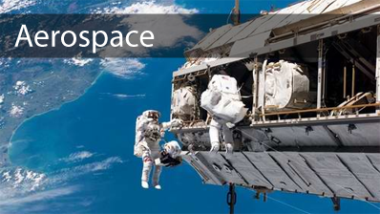
aero-, aer-, aeri-
3
AEROPLANE
AEROBICS
air
mist
wind

Slide 5
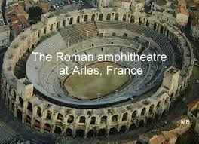
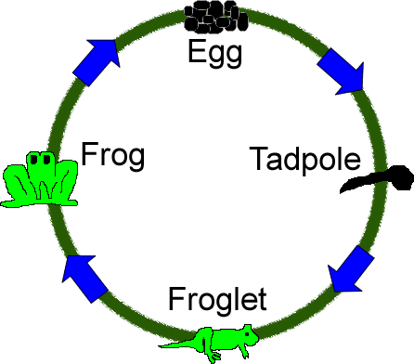
ampho-, amph-, amphi-
4
AMPHIBIAN
ambidextrous - able to use both hands equally
around
about
both
on both sides of
both kinds

Slide 6
a-, an-
achromatic - without color
5
abyss - without bottom
no
absence of
without
lack of
not

Slide 7
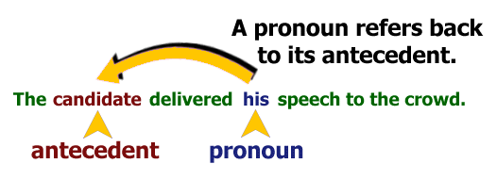
ante-, ant-
6
(verb) to be/go before (earlier in time)
ante= before
bell= war
BEFORE or existing BEFORE a WAR, especially the American Civil War (1861 to 1865)
before
in front of
prior to
forward

Slide 8
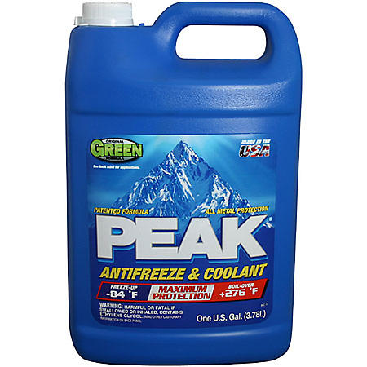
anti-, ant-
antibody - a substance that destroys micro-organisms
7
antisocial - opposing social norm
antiseptic - preventing infection
against
opposed to
preventive
reverse
antifreeze

Slide 9
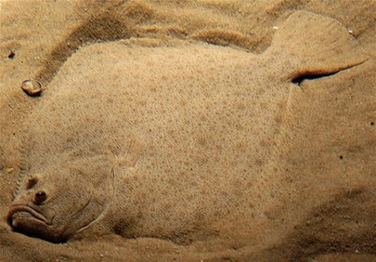
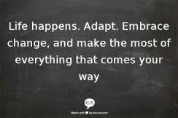
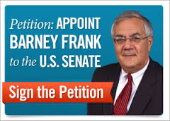
ad- ap- changes to: ac-, af-, ag-, al-, an-, ap-, aq-, ar-, as-, at- when ad- is combined with certain words that begin with the letters c, f, g, l, n, p, q, r, s, and t
8
ADAPTATION
to
toward
a direction toward
addition to
near
at

Slide 10
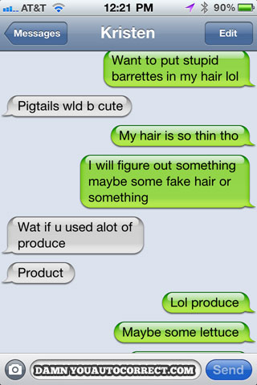
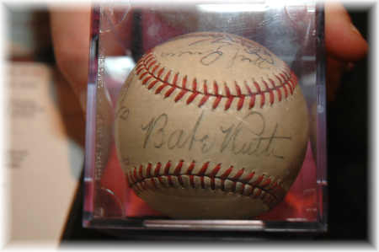
auto-, aut-
9
AUTOPILOT
AUTOCORRECT
AUTOGRAPH
self
same
spontaneous
directed from within

Slide 11
bene-, ben-, beni-
10
BENEFACTOR
a person who gives money or other help to a person or cause.
be·nev·o·lent
bəˈnevələnt/
adjective
adjective: benevolent
well meaning and kindly
good
well

Slide 12
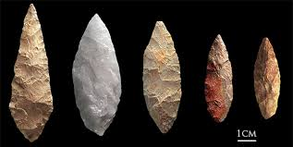
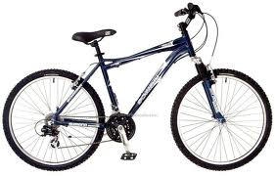
bi-, bin-, bino-, bis-
11
BIFACIAL
BICYCLE
it normally functions as a prefix
two
twice
double
twofold
a number;

Slide 13
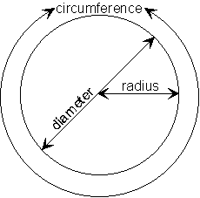
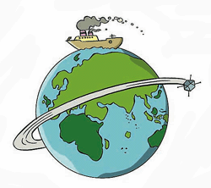
circum-
12
CIRCUMNAVIGATE
around
about
surrounding
closed curve
circling
circular on all sides
literally, "in a circle"

Slide 14
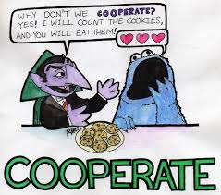
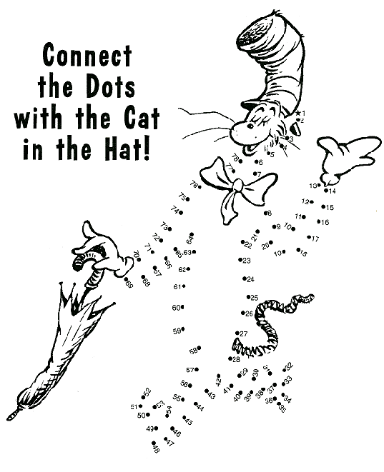
com- co-, cog-, col-, con-, cor-
13
COMPLETE
together
together with
with

Slide 15
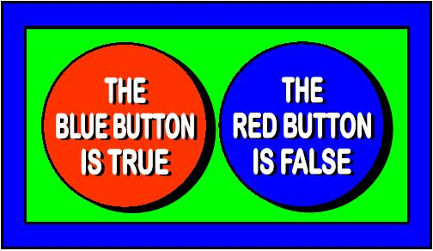
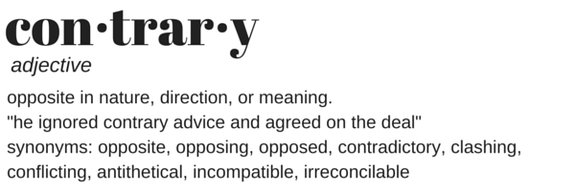
contra-, contro-, counter, contre-
CONTRADICTION
14
CONTRADICTORY
detect, identify, assess, counter, exploit and/or neutralize adversarial, foreign intelligence services, international terrorist organizations, and insider threats to the United States Army and U.S. Department of Defense.
against
opposed to
opposite
conflicting
different
clashing
unaccommodating

Slide 16
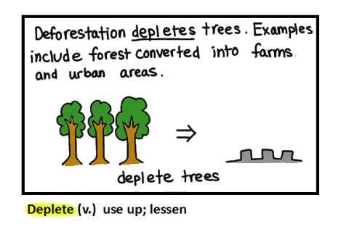
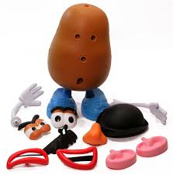
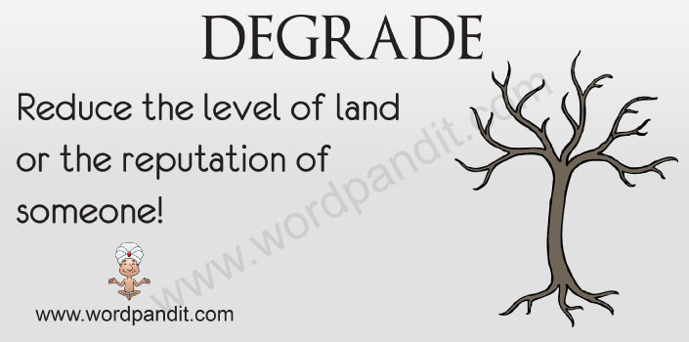
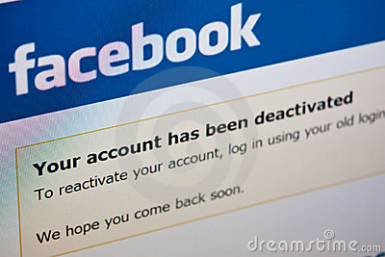
de-
15
DETATCH
DEBUG
DESCEND
DETHRONE
from away from
off down
entirely wholly complete utterly
reverse the action of undo

Slide 17
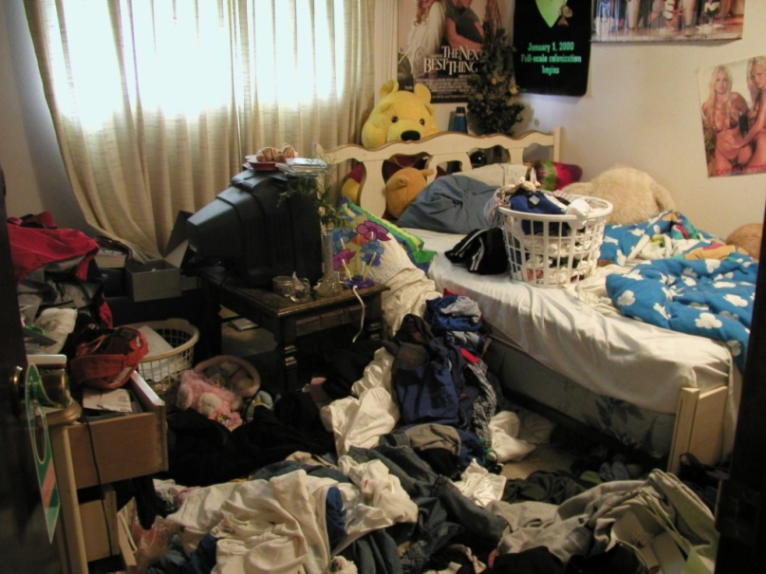
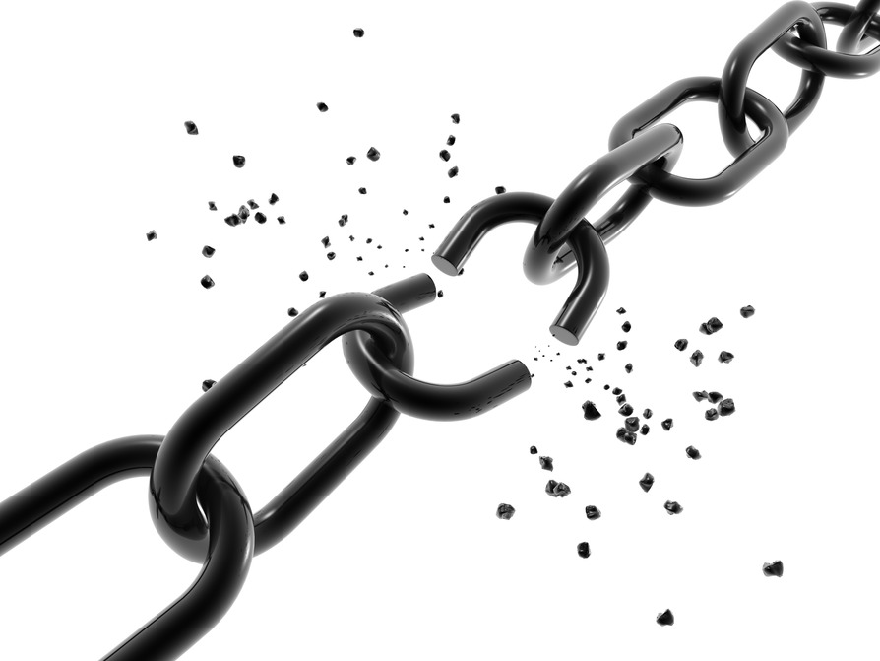
dis-, di-, diff-
16
DISARRY
DISCONNECT
separation apart asunder
removal away, from
negation deprivation
undoing reversal
utterly completely
in different directions
DIVIDE
differ, disallow, disperse, dissuade, disproportion, disrespect, distemper

Slide 18
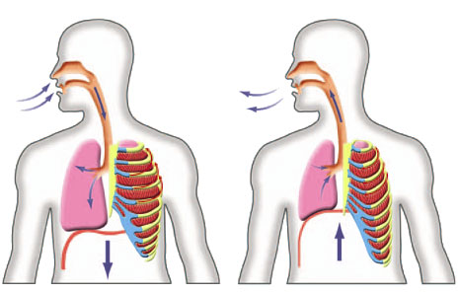
ex-, ec-, e- ex-, e-, ef-
17
INHALE EXHALE
Latin:
out
out of
from
upward
completely entirely
to remove from deprive of without
former
Greek:
out of
out
outside
away from
exclusive, ex-mayor
EXPLOSION

Slide 19
extra-, extro-, extr-, exter-
18
EXTRATERRESTRIAL
EXTRACURRICULAR ACTIVITIES
beyond
outside
on the outside
outward
external
external, extrinsic, extraordinary, extrapolate, extraneous, extrovert

Slide 20
for-
19
FORBID
not
end a game before it finishes

Slide 21
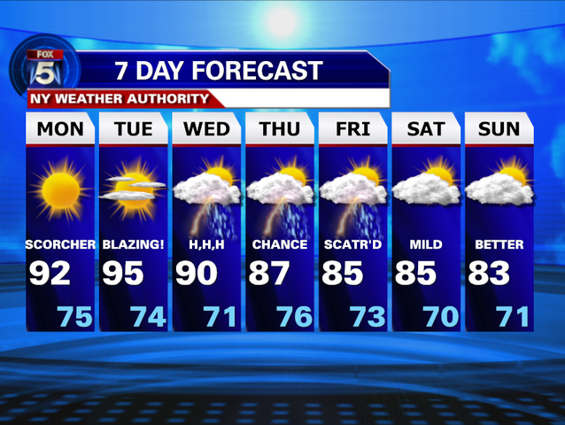
fore-
20
before

Slide 22
hyper-
21
over
above
excessive too much

Slide 23
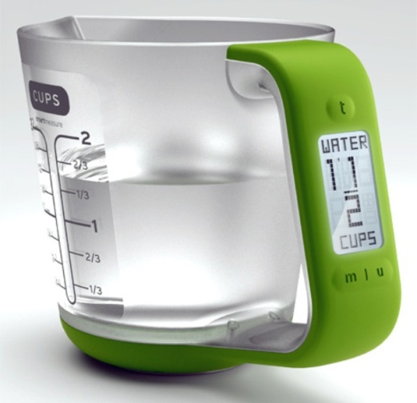
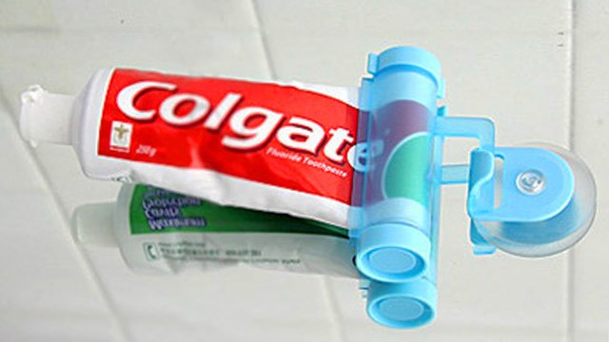
il-, in-
22/25
in
into
inside
on
toward

Slide 24
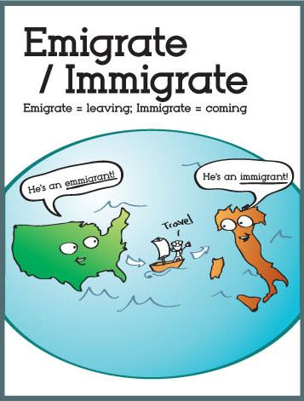
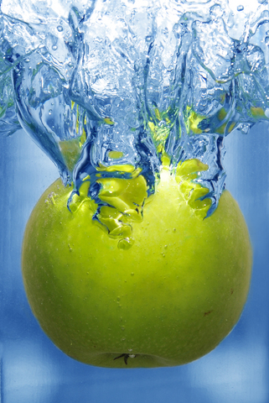
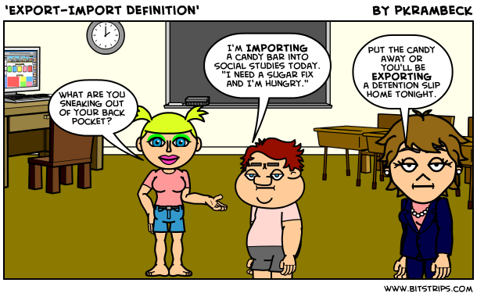
im-
immersed under water
23
into

