Slide 1
Prefixes
Prefixes are found BEFORE a base word and can change a words’ meaning.

Slide 2
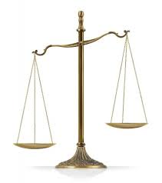
ig, il, im, in, ir
22/24/25/28
imbalance
not legal
impossible: not possible
responsible
vs irresponsible
not
without

Slide 3
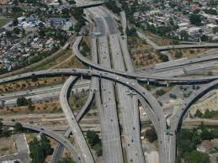
inter-
26
interchange highway
among
between

Slide 4
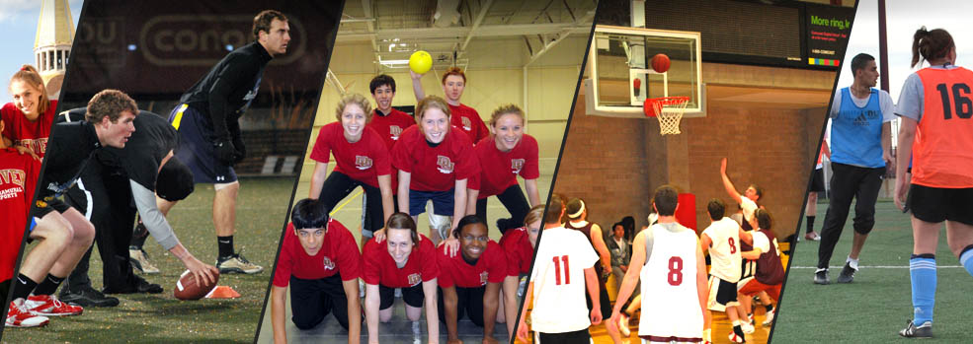
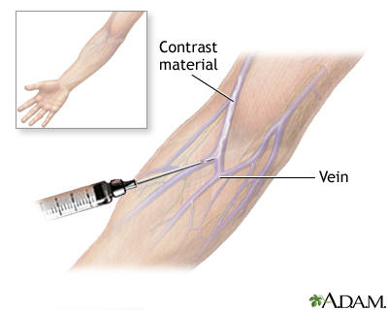
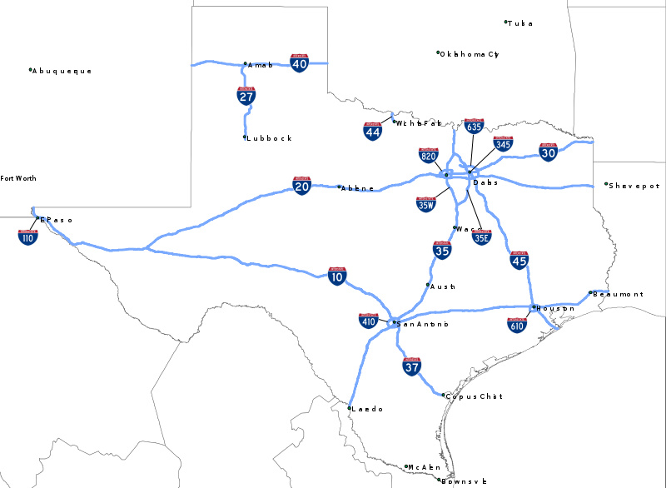
intra-
intramural - involving only students at the same school or college:
2.within the walls, boundaries, or enclosing units
27
intrastate – existing or occurring within the boundaries of a state
intravenous – within a vein
within
intrapersonal communication

Slide 5
ir-
28
ir·rel·e·vant əˈreləvənt/
adjective
adjective: irrelevant
not connected with or relevant to something.
not

Slide 6
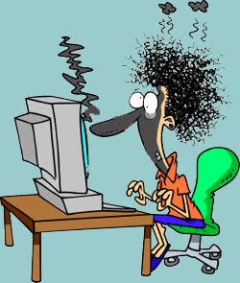
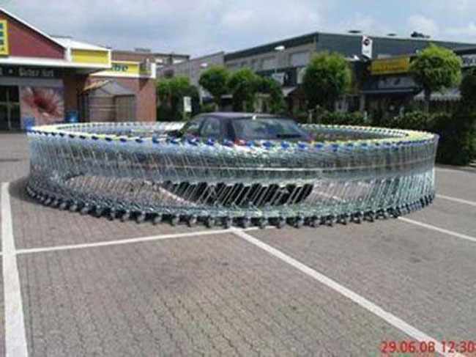
mal-, male, mali -
29
malfunction – failure to function properly
malicious intent
bad badly
harsh
wrong
ill evil
abnormal defective
Maladjusted - badly or unsatisfactorily adjusted, especially in relationship
to one's social circumstances, environment, etc.

Slide 7
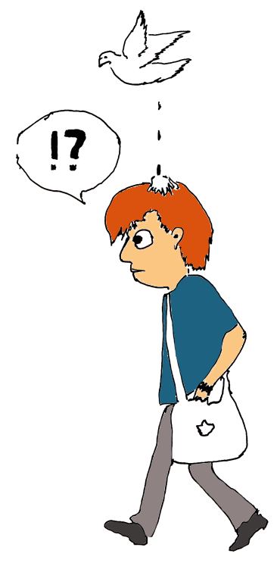
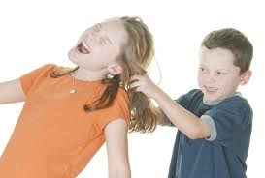
mis-
30
mistake
misfortune – bad luck
misbehave
misconduct - unacceptable or improper behavior,
especially by an employee or professional person.
bad
wrong
harsh

Slide 8
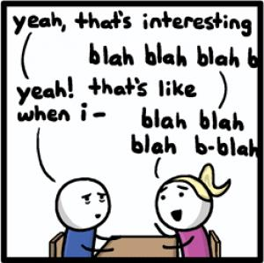
non-
31
nonpartisan - not biased or partisan, especially toward any particular political group.
non-stop talking
nonconformist
nothing
not

Slide 9
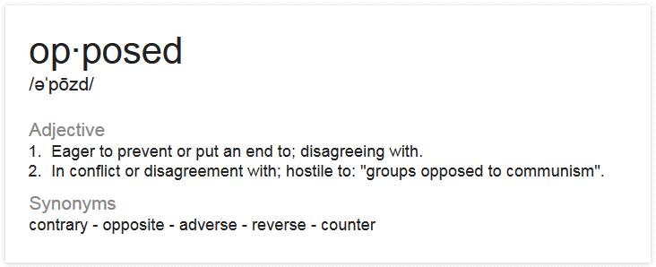
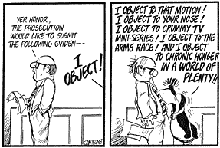
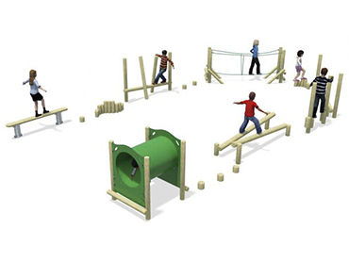
ob- before c, ob- becomes oc- before f, ob- becomes of- before g, ob- becomes og- before p, ob- becomes op- opposed before m, ob- becomes o-
32
objection
object
obstacle - a thing that blocks one's way or prevents or hinders against the intended progress
against

Slide 10
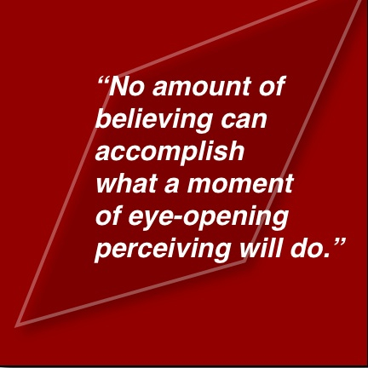
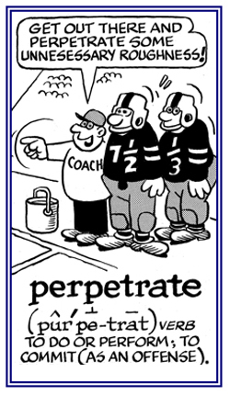
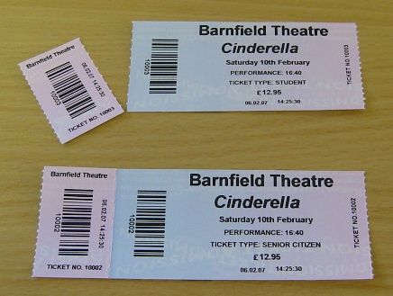
per-
perceive - become aware or conscious of (something); come to realize or understand.
state of being or process of becoming aware of something
33
perforated paper
through
across
over
beyond
by means of
percolate - To cause (liquid, for example) to pass through a porous substance
or small holes 2. To pass or ooze through

Slide 11
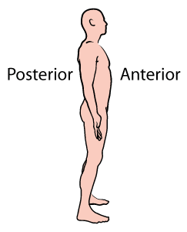
post-
34
postgraduate – of or relating to studies done after earning a bachelor’s degree
posterior - further back in position; of or nearer the rear or hind end, especially of the body or a part of it.
after
behind
later
subsequent

Slide 12
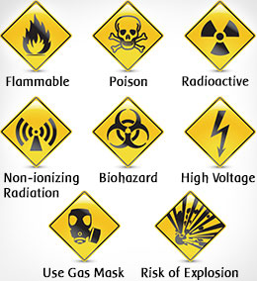
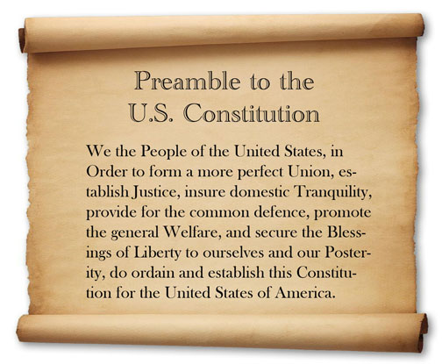
pre-
35
precaution - a measure taken in advance to prevent something dangerous,
unpleasant, or inconvenient from happening.
preamble - 1 : an introductory statement; especially : the introductory part of a constitution or statute that usually states the reasons for and intent of the law. : an introductory fact or circumstance; especially : one indicating what is to follow.
prearrange- arrange or agree upon in advance
before

Slide 13
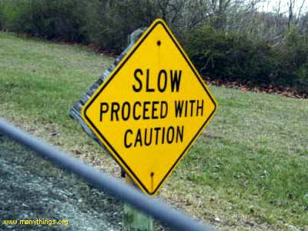
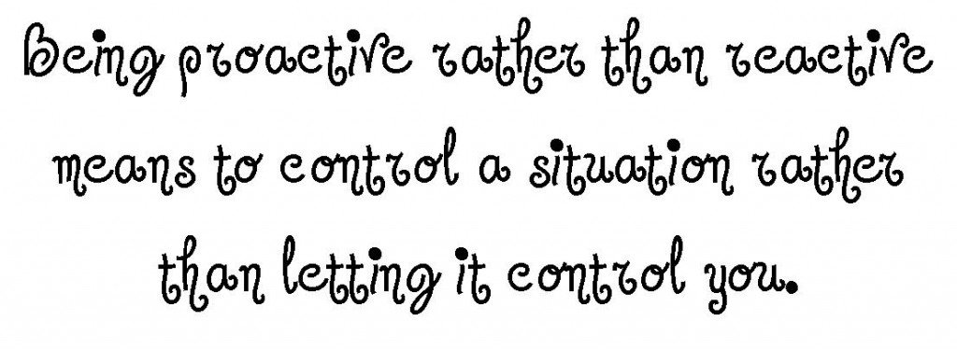
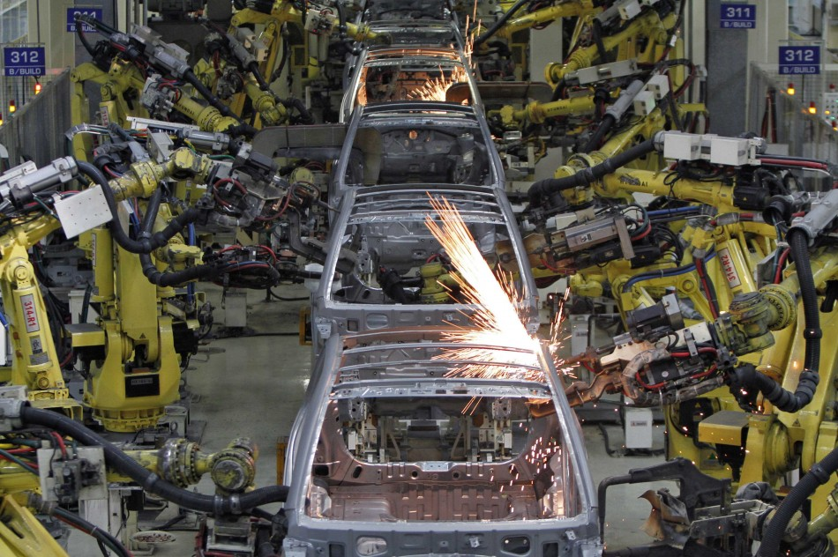
pro -
proceed - move forward, especially after reaching a certain point.
36
produce - make or manufacture from components or raw materials.
before, for

Slide 14
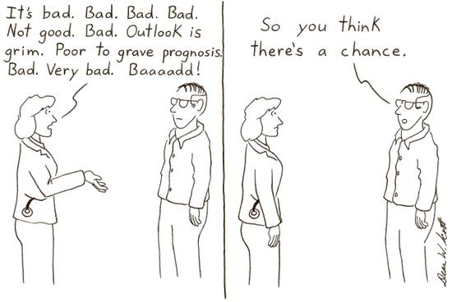
pro-, por-, pur-
37
prophet - a person regarded as an inspired teacher or proclaimer of the will of God.
program - a planned series of future events, items, or performances.
"a weekly program of films"
prognosis - the likely course of a disease or ailment,
a forecast of the likely course of a disease or ailment.
a prefix signifying before
forward, forth; for, in favor of; in front of; in place of, on behalf of; according to; as, to place before; to go before or forward, to throw forward

Slide 15
re-
recall - ring (a fact, event, or situation) back into one's mind,
especially so as to recount it to others; remember.
38
recede - to go or move away; retreat; go to or toward a more distant point; withdraw.
reflect - (of a surface or body) throw back (heat, light, or sound) without absorbing it.
back; again
recall, recede, reflect, redo, repay,

Slide 16
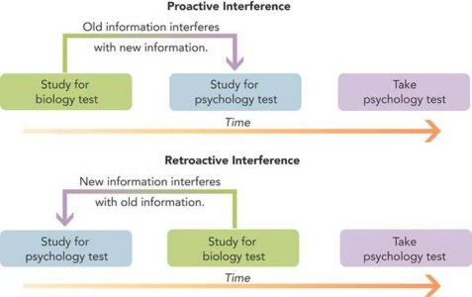
retro-
39
retrocede
ret·ro·spect ˈretrəˌspekt/
noun
noun: retrospect; plural noun: retrospects
a survey or review of a past course of events or period of time.
backward

Slide 17
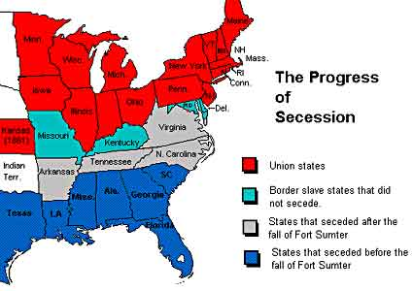
se-
40
secure- dependable; firm; not liable to fail, yield, become displaced
secession- the act of separating from a nation or state and becoming independent.
apart

Slide 18
self-
41
self-taught- educated by your own efforts
self-worth- the sense of one's own value or worth as a person
selfish- having or showing concern only for yourself
and not for the needs or feelings of other people
self-respect
of the self

Slide 19
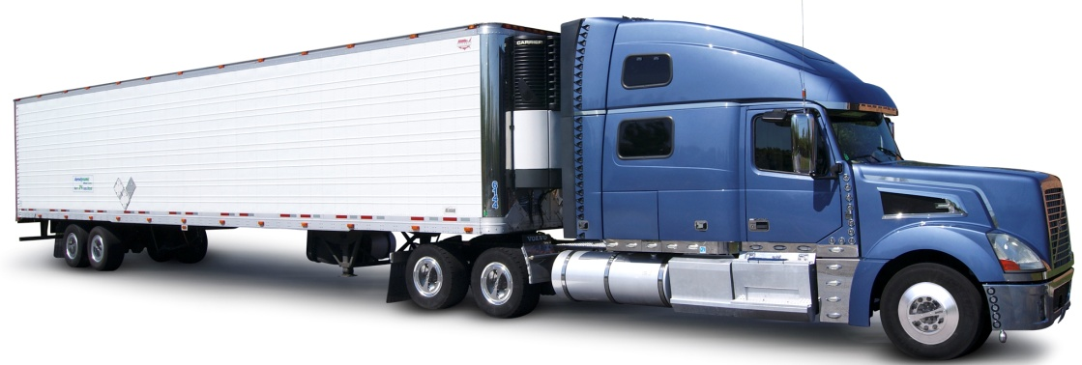
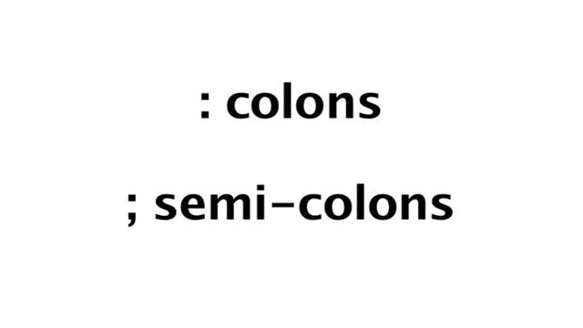
semi-
42
semi-circle- A half of a circle as divided
by a diameter.
semi truck
semiformal- somewhat formal : not informal but not highly formals
half
partly

Slide 20
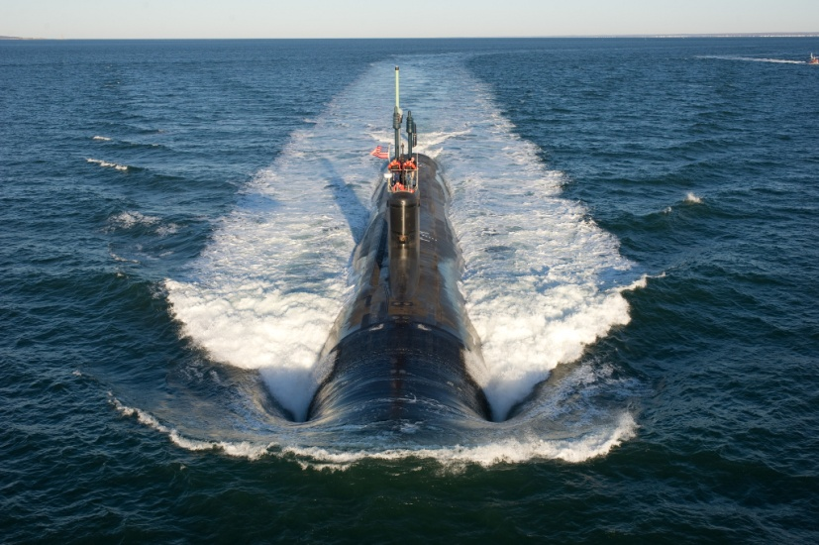
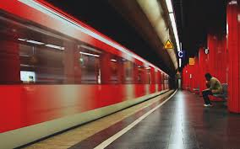
sub-
43
submarine - a boat, particularly a warship, designed to stay and travel under the surface of the water for a long time
submerge - to put or sink below the surface of water
subway - a system of underground trains in a city.
under
beneath

Slide 21
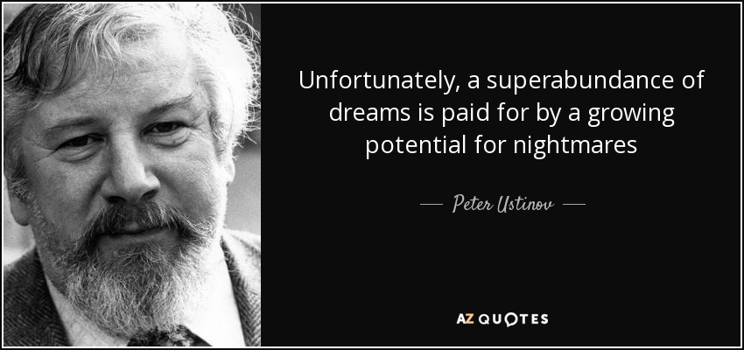
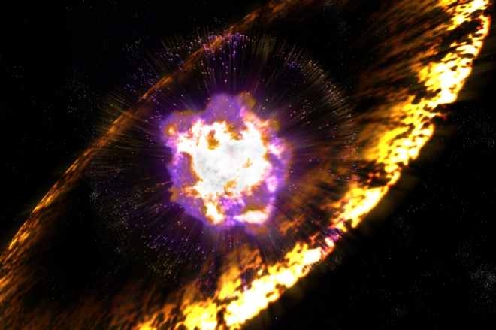
super-
44
superabundance
superman - a man who is very strong, successful,
Superabsorbent polymers (SAPs) (also called slush powder) are polymers that can absorb and retain extremely large amounts of a liquid relative to their own mass. Water-absorbing polymers, which are classified as hydrogels when cross-linked, absorb aqueous solutions through hydrogen bonding with water molecules
supernova - the explosion of a star
over

Slide 22
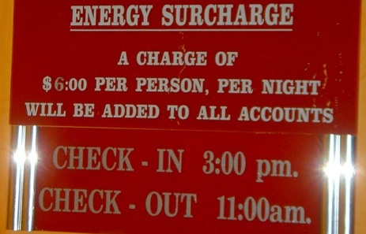
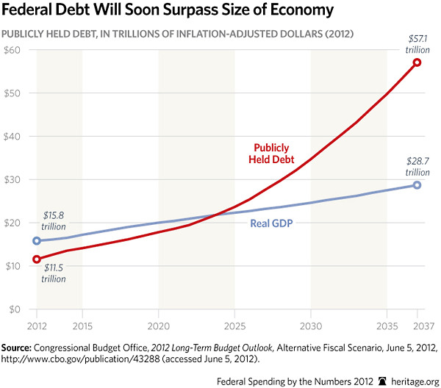
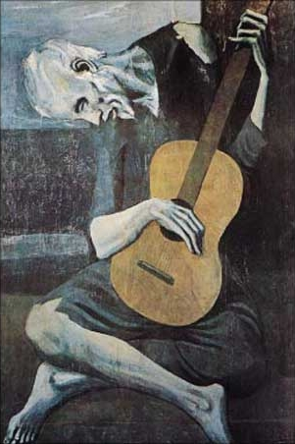
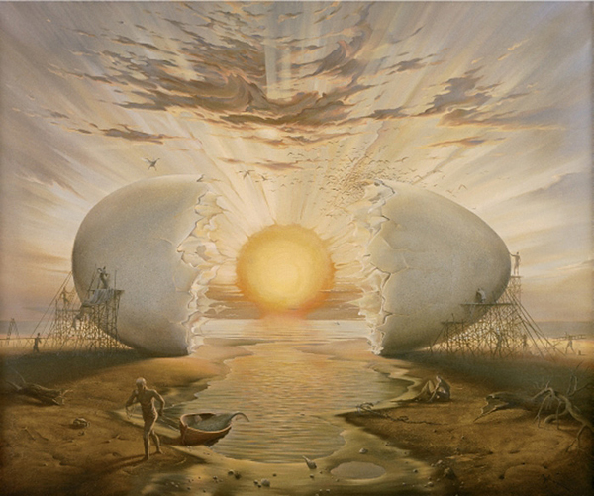
sur-
45
surcharge - an additional charge, tax, or cost.
surrealism - expressing imaginative dreams and visions free from conscious rational control.
over
above

Slide 23
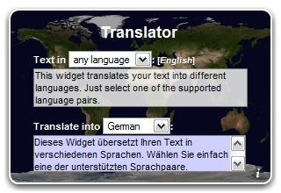
trans-
transfer -to convey or remove from one place, person, etc., to another
46
across
over

Slide 24
ultra-
47
Ultraviolet light is a form of radiation which is not visible to the human eye.
ultrasonic sound - used to describe sounds that are too high for humans to hear.
extremely
ultramodern - Extremely modern in ideas or style;

Slide 25
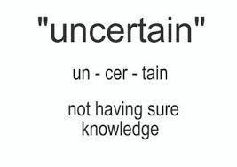
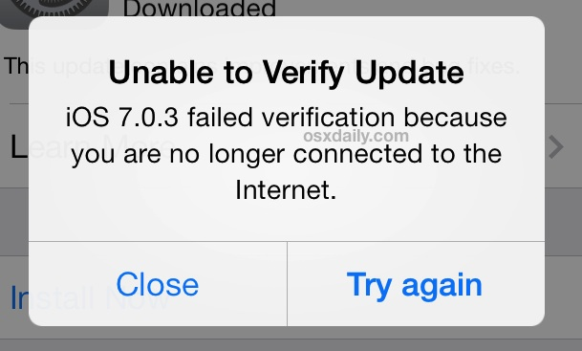
un-
48
unstable - not stable; not firm or firmly fixed; unsteady.
not
lack of
opposite
unhappy

