Slide 1
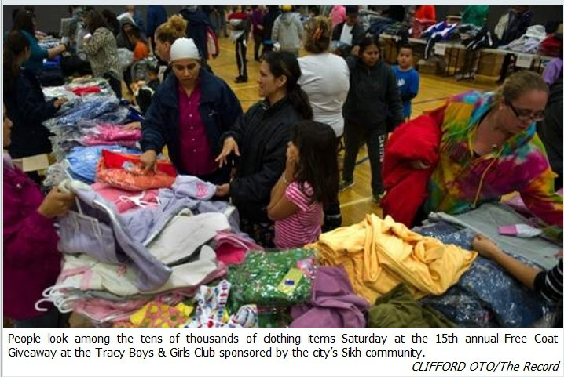
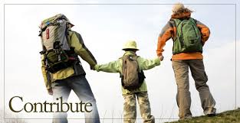
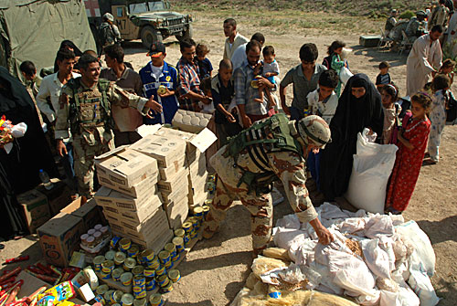
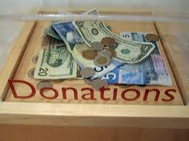
tribu-, trib-
Con – together
Tribu - give
DISTRIBUTE
to allot
to give
to assign , to grant, to bestow
from tribe
to give out among the tribes

Slide 2
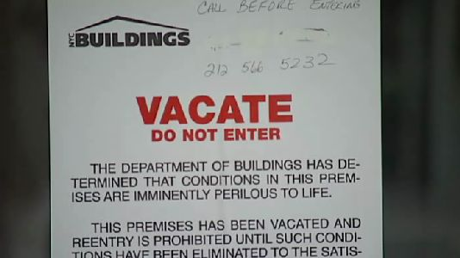
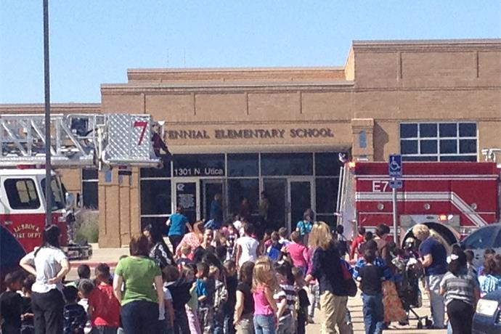
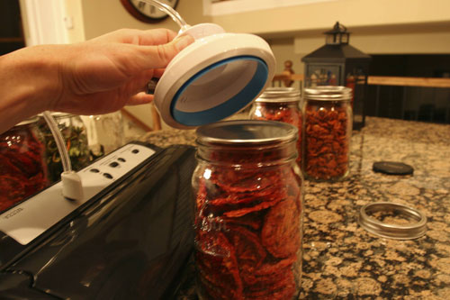
vacu-
E – out
Vacu – empty
Evacuate- empty out
evacuate
vacuum sealed
to empty

Slide 3
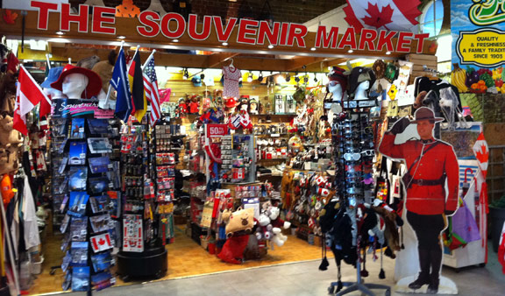
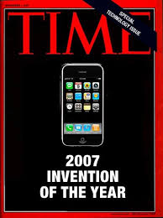
ven-, vent-, veni-, ventu-
INVENT
SOUVENIR: comes from _____
PREVENT:
before the germs come
to come to a new place
Ad – to, motion toward Ventu – to come Ure – act, process
Adventure – motion, action, toward
to come

Slide 4
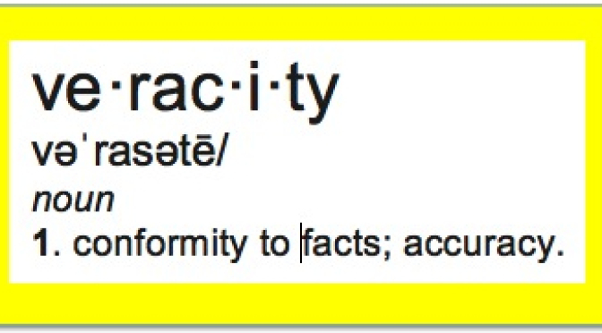
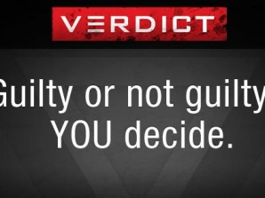
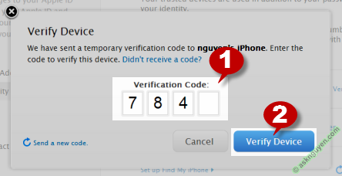
ver
true
truth
real
truthfulness

Slide 5
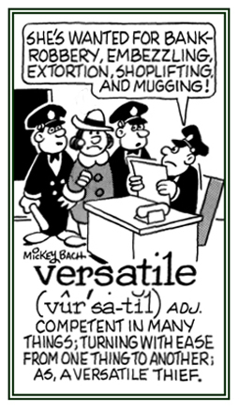
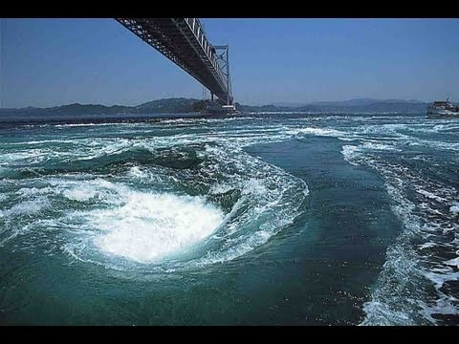
vers-, vert-, -verse, -version, -version, -versation, -versal, -versary, -vert, vort-, vors-
Ad – to motion toward
Vers – turn
Ary- person
bend
turn

Slide 6
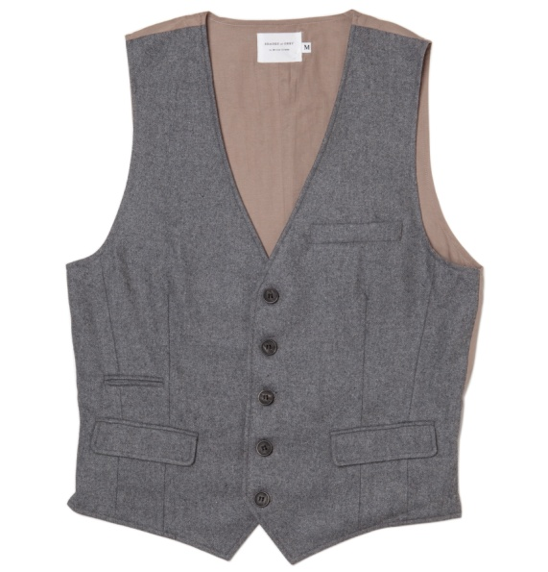
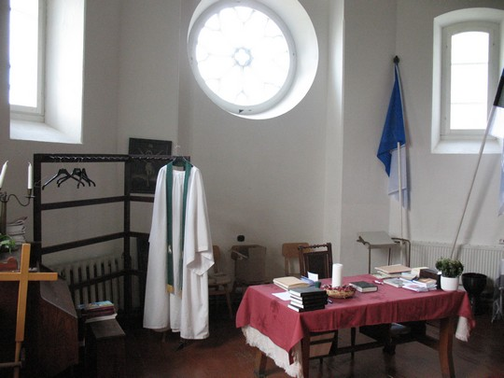
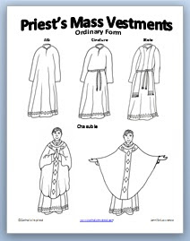
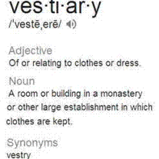
vesti-, vest-
vestry
covering for the body
clothes
garment

Slide 7
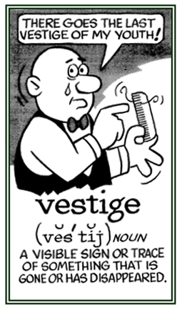
vestig-, vestigi-
footprint
tracking
to track
to trace

Slide 9
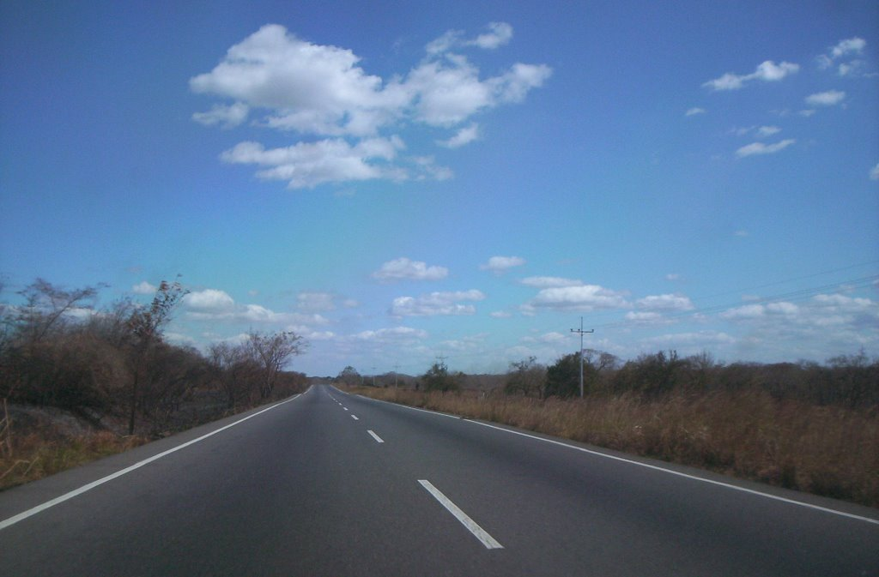
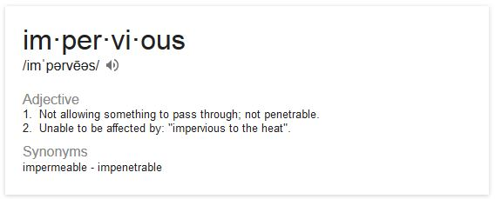
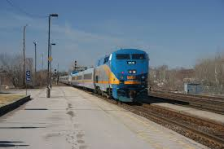
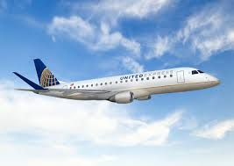
via- [-vey, -voy-]
via
car/road
train
plane
etc.
way
road
path

Slide 10
vir-, viri-, virtu-
Virile, virility virtues
Manliness
worth
manhood
masculine
husband

Slide 11
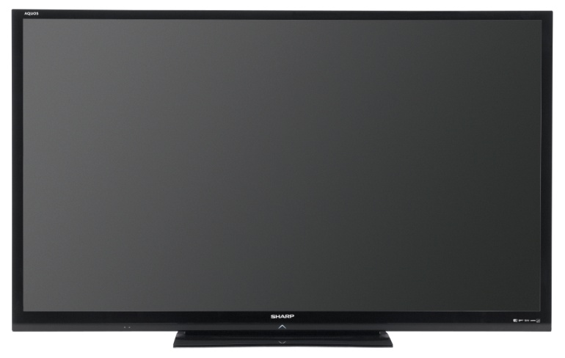
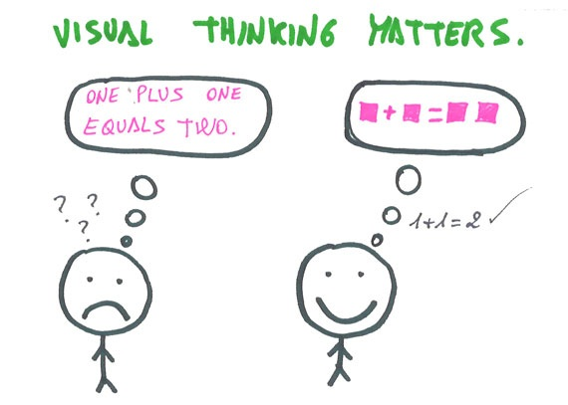
vid-, video-, vis-, -vision, -visional, -visionally, visuo-, vu-
VISIONARY
videre, "to see“
plus words with other related meanings: to notice, noticing, noticed; observe, observing, observed; look, looking, looked; perceive, perceiving, perceived, perception; see, seeing, saw, seen, sight; view, viewing, viewed; manifest, manifesting, manifested; reveal, revealing, revealed, revelation

Slide 12
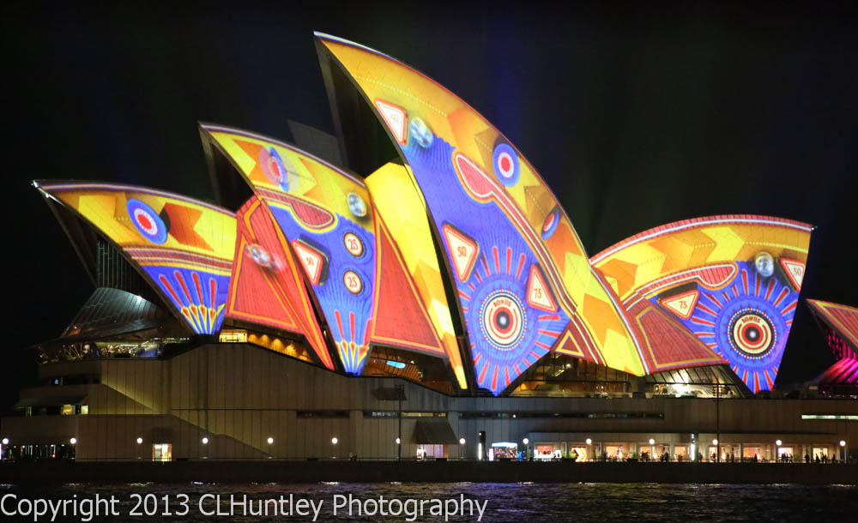
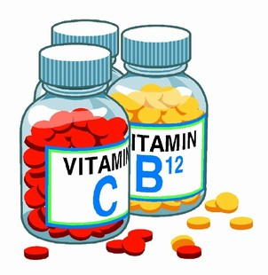
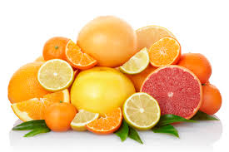
Viv, vit
vivacious
vivid colors
Life
Vivacious, vivid, vital

Slide 13
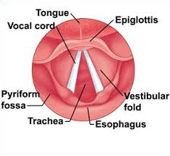
Voc, vok
Voice, call
Invocation, revoke, vocal

Slide 14
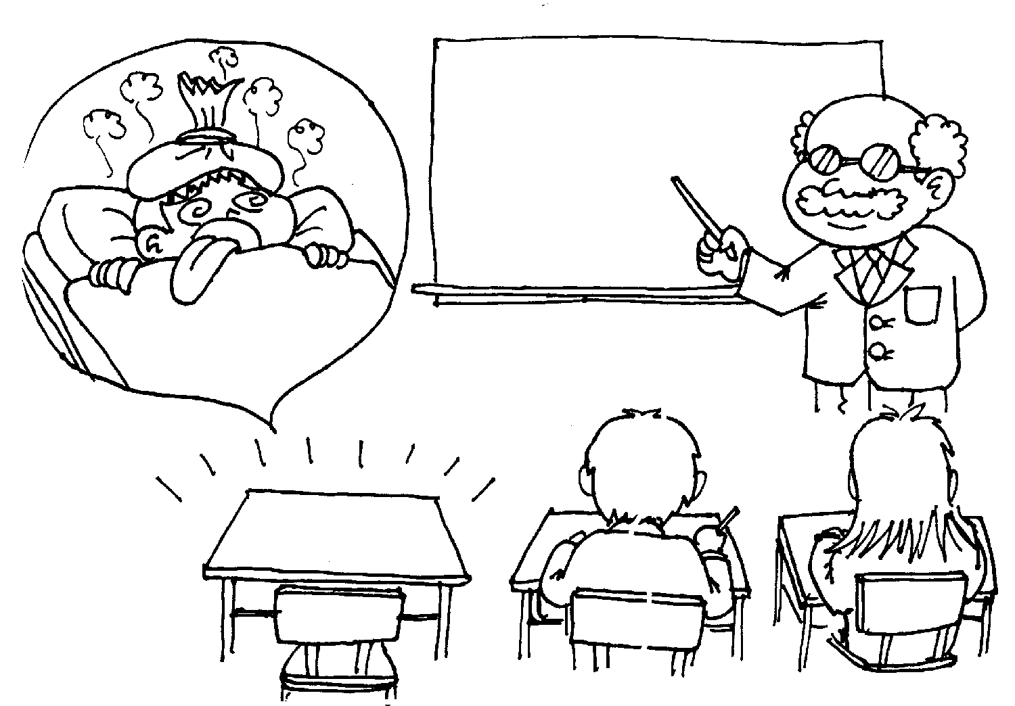
ab-
absent
abnormal abduct
from; away from
Abnormal, abduct, absent, abhor

Slide 15
ad-
adhesive
to; motion toward; addition to
adapt, addict, adhere, admit

Slide 16
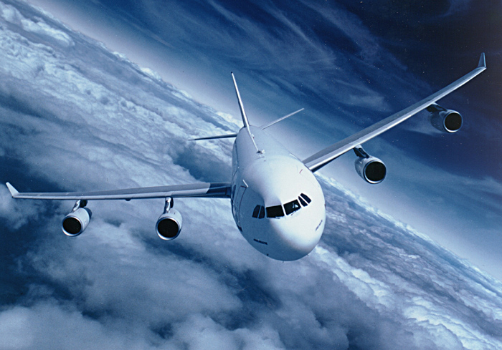
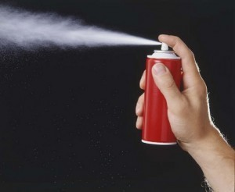
aero-
aerobics aerospace
aerosol
air
aerobic, aerobiology, aerospace

Slide 17
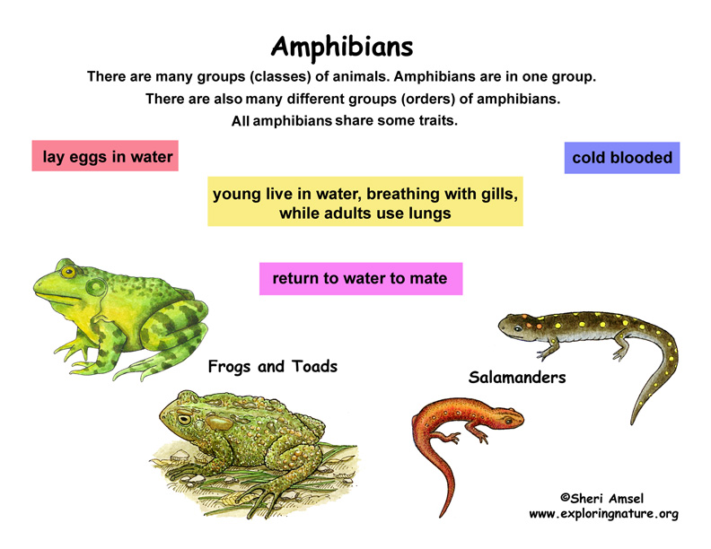
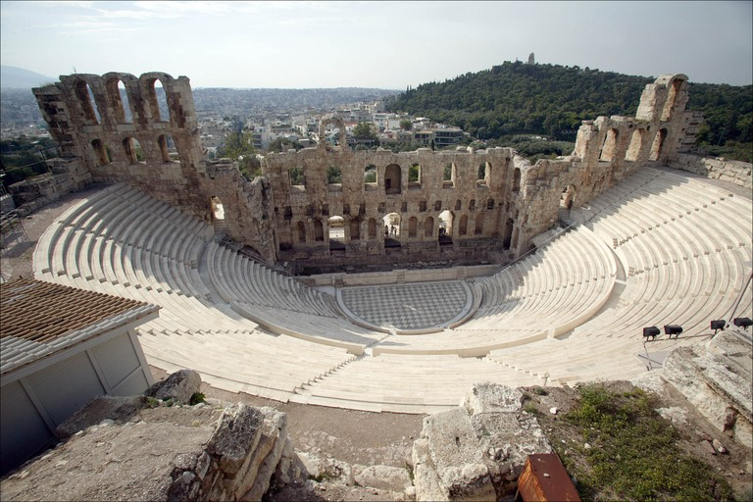
amphi-
both, around
amphibian, amphitheater

Slide 18
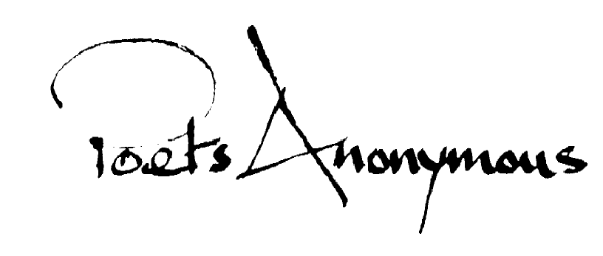
an-
not
anarchy, anesthesia, anonymous

Slide 19
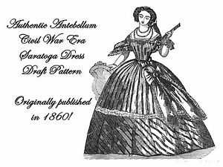
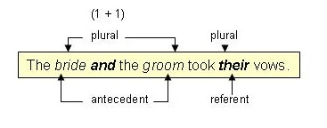
ante-
before
antebellum, antecedent, antecede, antedate

Slide 20
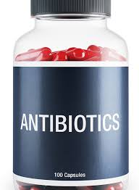
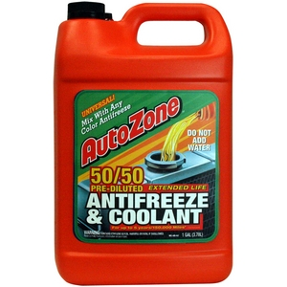
anti-
anti bullying
against, opposite; reverse
antiaircraft, antifreeze, antonym, antibiotics

Slide 21
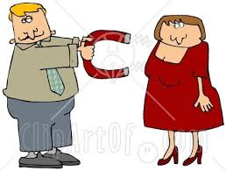
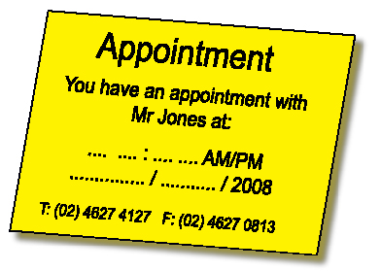
ap-
appeal approximate
to; nearness to
approximate, appoint

Slide 22
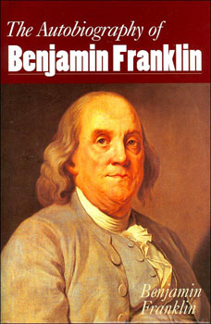
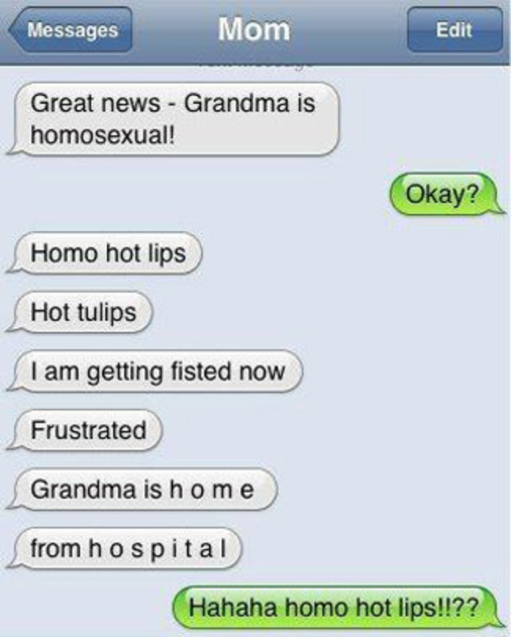
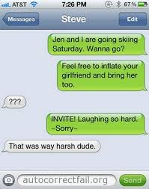
auto-
autocorrect
self
automatic, autograph, autobiography

Slide 23
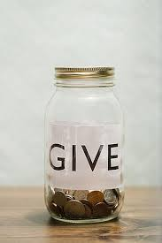
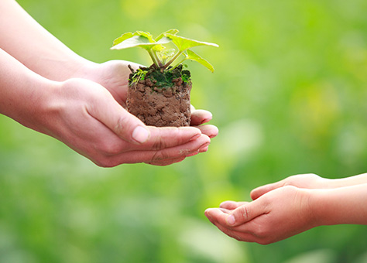
bene-, ben-, beni-
BENEFACTOR
a person who gives money or other help to a person or cause.
be·nev·o·lent
bəˈnevələnt/
adjective
adjective: benevolent
well meaning and kindly
good
well

Slide 24
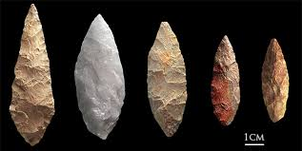
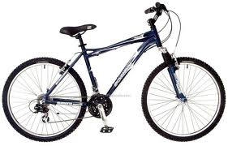
bi-, bin-, bino-, bis-
BIFACIAL
BICYCLE
it normally functions as a prefix
two
twice
double
twofold
a number;

Slide 25
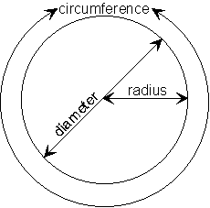
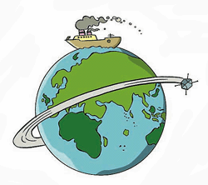
circum-
CIRCUMNAVIGATE
around
about
surrounding
closed curve
circling
circular on all sides
literally, "in a circle"

Slide 26
com- co-, cog-, col-, con-, cor-
COMPLETE
together
together with
with

