Slide 2
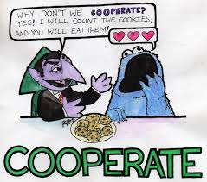
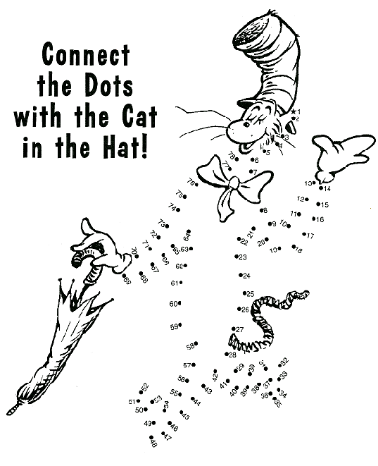
com- co-, cog-, col-, con-, cor-
COMPLETE
together
together with
with

Slide 3
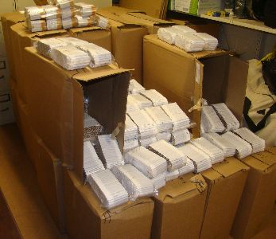
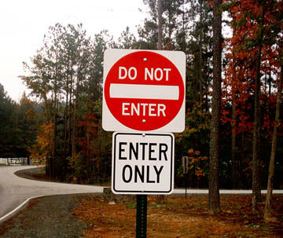
Contra-
Contraband – anything against the law to sell or buy
Contradict - to express the opposite
Contrary – completely different opposite in
Nature, opinion, or action
Against
Opposite

Slide 4
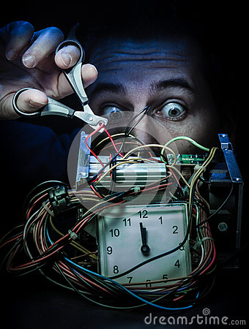
de-
Deform – distort the shape or form of;
De- opposite, away from
Form—shape, form
decline – de- opposite of, down,
Cline – to lean, lie, bend
(to go or bend down)
Deactivate – to make not active or inactive
De opposite
Act – do drive
Opposite of;
away from; undo
down

Slide 5
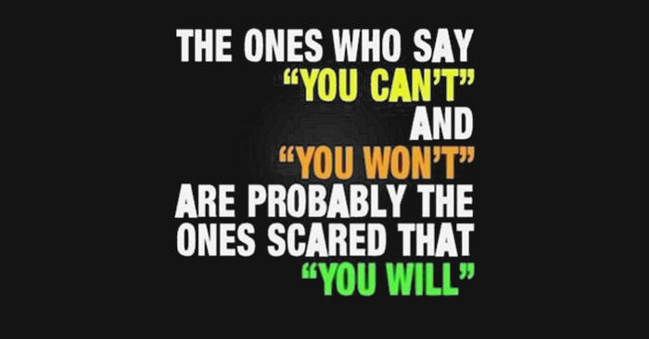
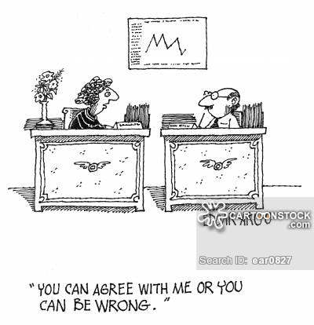
dis-
dishonest- opposite of honest
Discourage - cause (someone) to lose confidence or enthusiasm.
Opposite of encourage
opposite
Disagree to have a different opinion

Slide 6
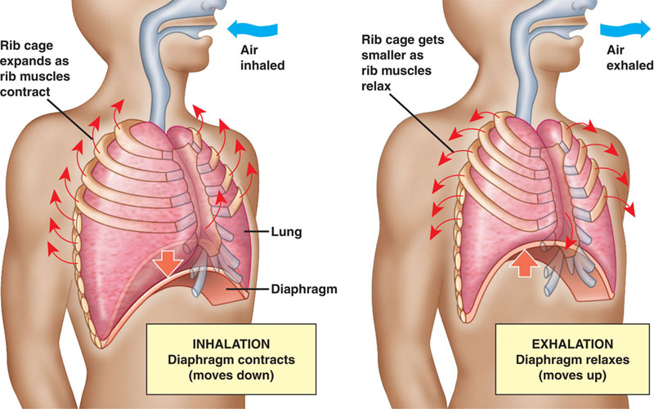
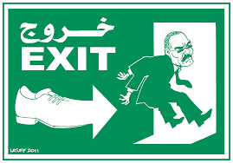
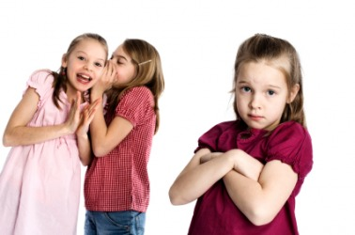
Ex-
Exhale breathe out in a deliberate manner.
Exit – a way out
Out; beyond; away from; former
Exclude - keep (something) out of a place.

Slide 7
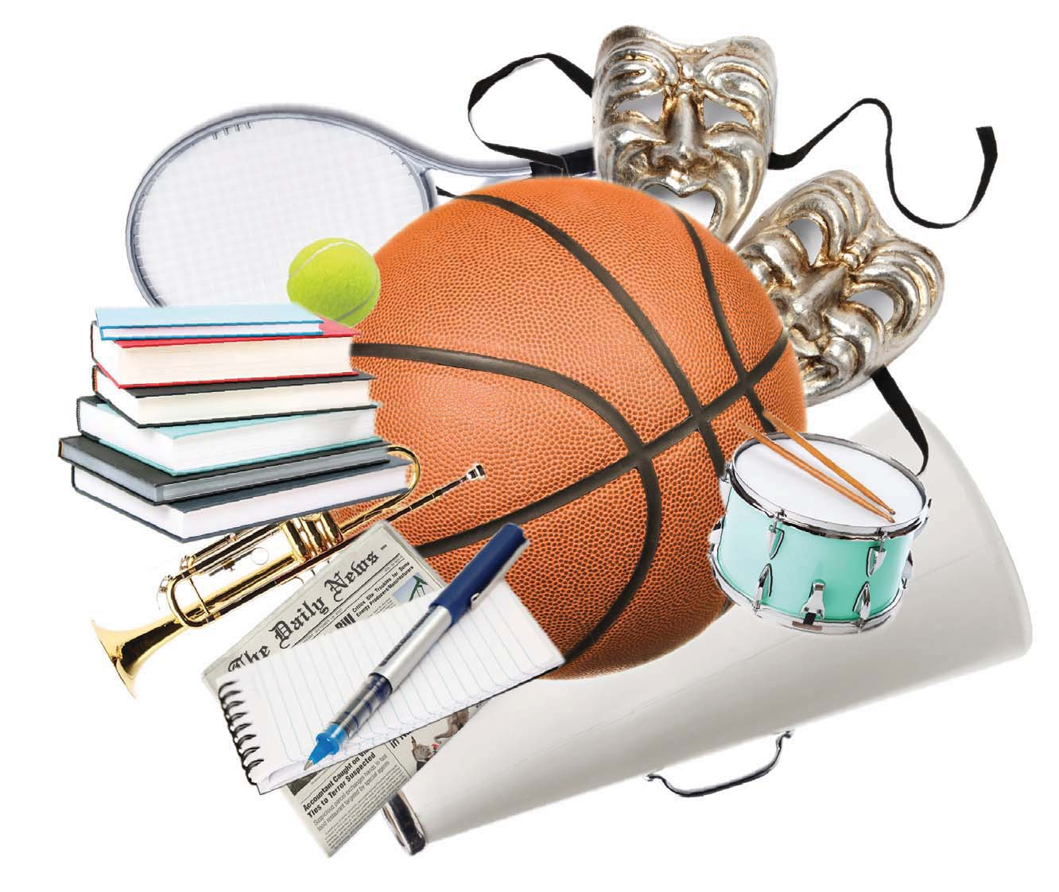
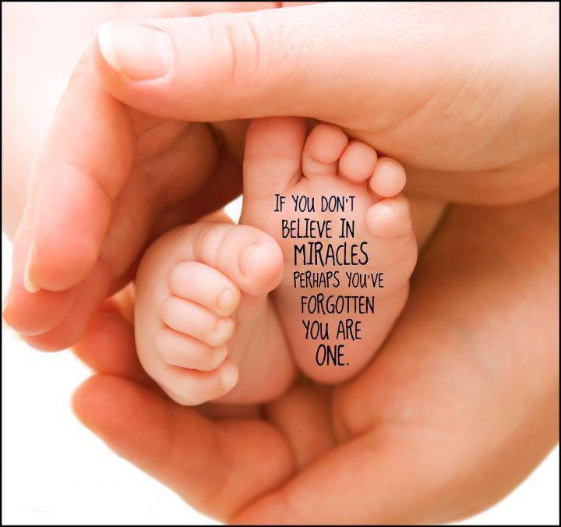
Extra-
Extracurricular - (of an activity at a school or college) pursued in addition to the normal course of study.
Exit – a way out
Extraordinary- very unusual or remarkable. (beyond ordinary).
Outside; beyond; besides

Slide 8
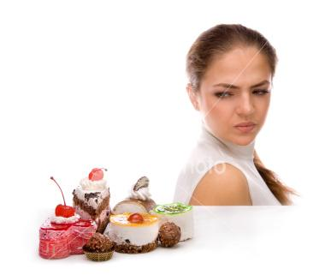
For-
Forget - fail to remember.
Forbid - refuse to allow (
Forgo - omit or decline to take (something pleasant or valuable); go without.
Not ,

Slide 9
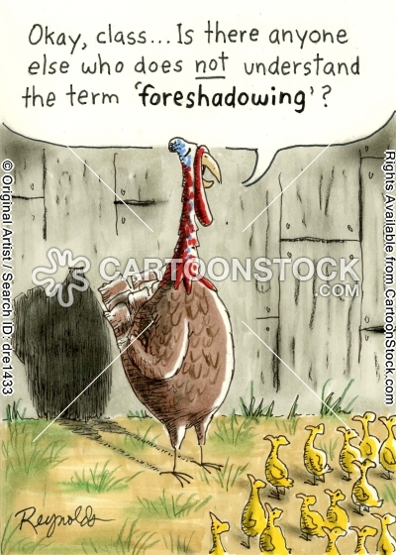
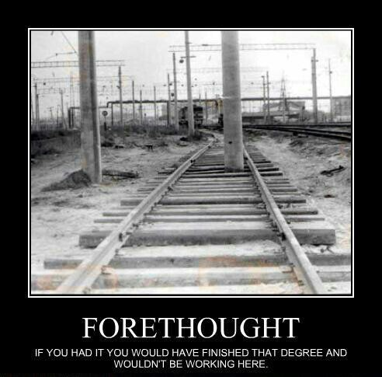
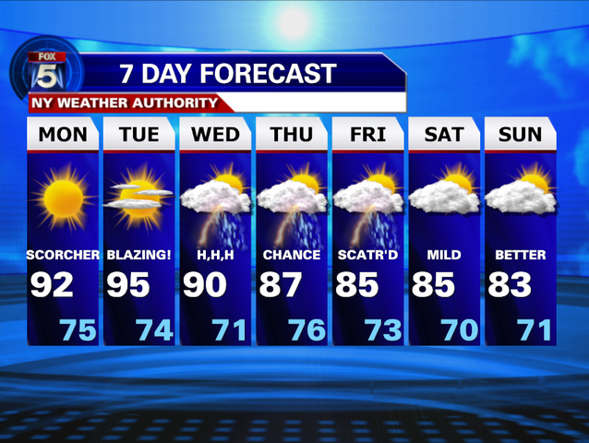
Fore-
Forethought - careful consideration of what will be necessary or may happen in the future.(
Foreshadow - be a warning or indication of (a future event).
Forecast predict or estimate (a future event or trend).
before

Slide 10
Hyper-
Hyperactive - abnormally or extremely active.
More than normal; too much
Hyperactive, hypercritical

Slide 11
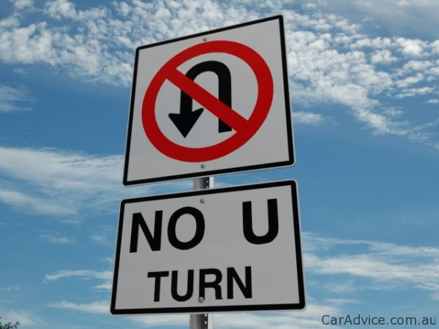
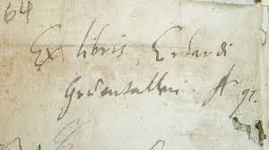
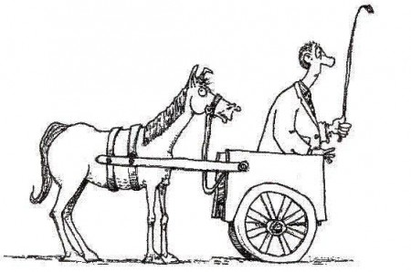
il-
Illegible - not clear enough to be read.
Illegal - contrary to or forbidden by law,
especially criminal law.
Not
Illegal, illegible, illogical
Illogical - lacking sense or clear, sound reasoning.

Slide 12
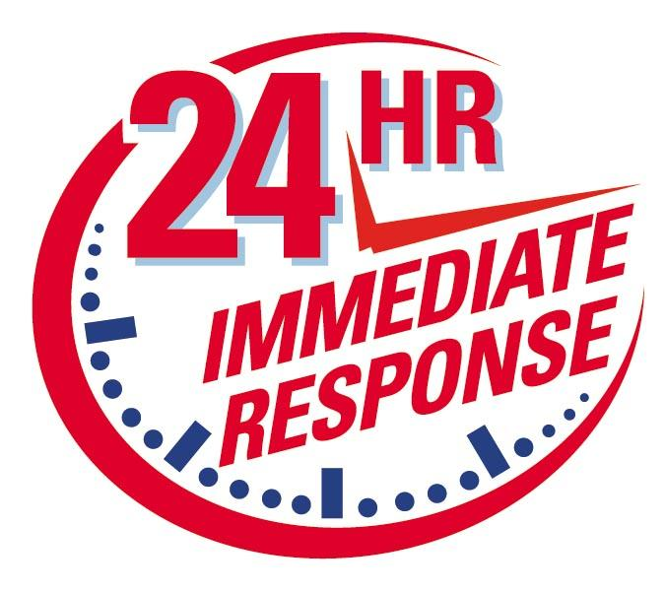
Im-
immediate - occurring or done at once; instant.
im – into
medi –middle
ate –
immigrate - come to live permanently in a foreign country.
Into
Immediate, immerse, immigrate, import
immerse - dip or submerge in a liquid.

Slide 13
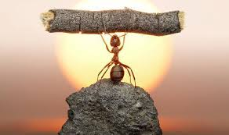
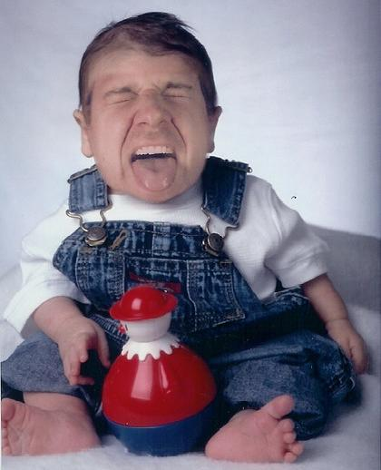
Im-
Immobilize - prevent (something or someone) from moving or operating as normal.
Immature -not fully developed.
Impossible - not able to occur, exist, or be done.
Not
Impossible, immature, immobilize

Slide 14
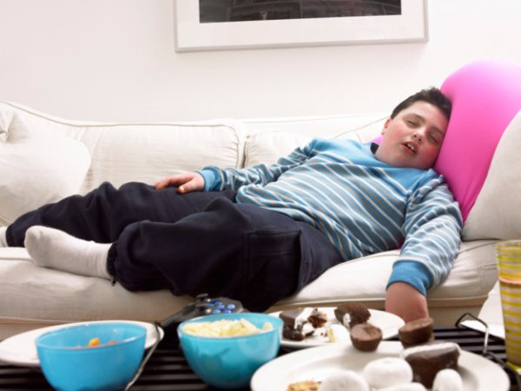
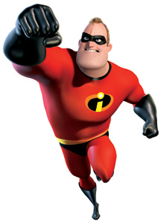
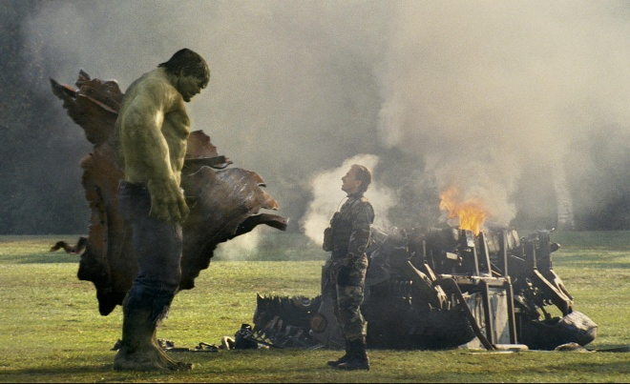
In
Inactive - not engaging in or involving any or much physical activity.
Incredible – not believable
Not
Incredible, inaccurate, inactive, indecisive
inaccurate- not accurate.

Slide 15
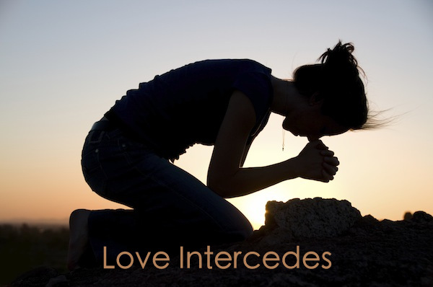
Inter-
Intercede - to act or come between on
behalf of someone in difficulty or trouble
Interaction - mutual or reciprocal action or influence
Among; between
Interaction, intercede, interchange

Slide 16
Intra-
Within
Intramural, intrastate, intraveneous

Slide 17
Ir-
Not
Irredeemable, irregular, irresponsible

Slide 18
Mal-
Wrong; bad
Maladjusted, malfunction malice

Slide 19
Mis-
Wrong; bad; no; not
Misfire, misbehave, misconduct

Slide 20
Non-
Not, opposite of
Noncommittal, nonconductor, nonpartican

Slide 21
Ob-
Against
Obstacle, obstinate, obstruct, object

